Slide 1
Terms and People
“new” immigrant – Southern and Eastern European immigrant who arrived in the United States in a great wave between 1880 and 1920
steerage – third-class accommodations on a steamship, which were usually overcrowded and dirty
Ellis Island – island in New York Harbor that served as an immigration station for millions of immigrants arriving to the United States
Angel Island – immigrant processing station that opened in San Francisco Bay in 1910

Slide 2
Terms and People (continued)
Americanization – belief that assimilating immigrants into American society would make them more loyal citizens
“melting pot” – society in which people of different nationalities assimilate to form one culture
nativism – belief that native-born white Americans are superior to newcomers
Chinese Exclusion Act – 1882 law that prohibited immigration by Chinese laborers
Notes:
2

Slide 3



Why did immigrants come to the United States, and what impact did they have upon society?
Immigrants came to the U.S. for religious and political freedom, for economic opportunities, and to escape wars.
Immigrants adopted parts of American culture, and Americans adopted parts of immigrant cultures.

Slide 4
The foreign-born population of the U.S. nearly doubled between 1870 and 1900.
In the 1840s and 1950s, German and Irish Catholics had immigrated to the United States.
Despite differences, their children were often able to blend into American society.
But starting in 1870, some people feared ”new” immigrants would destroy American culture.
Notes:
4

Slide 5
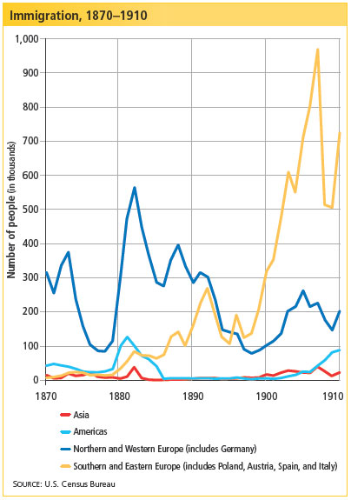
Immigrants to the United States from Southern and Eastern Europe made up 70 percent of all immigrants after 1900, up from 1 percent at midcentury.
Notes:
5

Slide 6
New vs. Old Immigrants
BEFORE 1890
From NW Europe (Germany, England, etc)
Skilled workers
Protestant Christian
Light skin
Common customs
AFTER 1890
From SE Europe
(Russia, Italy, etc)
Unskilled workers
Jewish or Catholic
Darker skin, eyes, hair
Different customs
Known as “New Immigrant”
Which group faced the most discrimination?
The After 1890 group, they looked different and had a different way of life

Slide 7
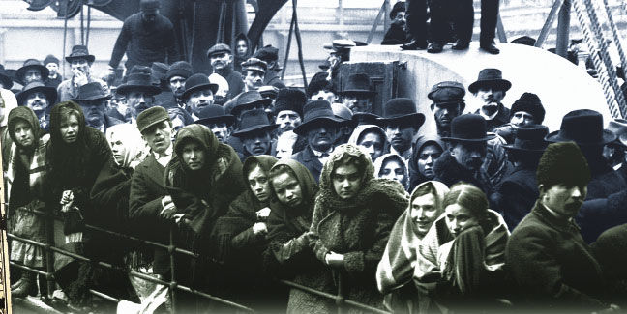
Coming to America was often a tough decision. Immigrants usually brought only what they could carry and traveled by steamship in steerage.
Notes:
7

Slide 8
Push factors for immigration are those that push people from their homes, while pull factors are those that attract them to a new place.
Push Factors | Pull Factors
Farmers were pressured by land reform and low prices. | The U.S. offered plentiful land, employment, and opportunity.
Revolution and war disrupted economies and left political refugees. | Many “chain immigrants” already had family in the U.S.
Religious persecution forced many to flee violence. | Immigrants could find religious and political freedom in America.
Notes:
8

Slide 9
When the immigrants arrived after their long journeys, they were processed at stations such as Ellis Island in New York Harbor.
There, officers conducted legal and medical inspections. Only 2 percent were denied entry into the U.S.
Chinese and other Asian immigrants crossing the Pacific were processed at Angel Island in San Francisco Bay. Many Chinese were turned away.

Slide 10
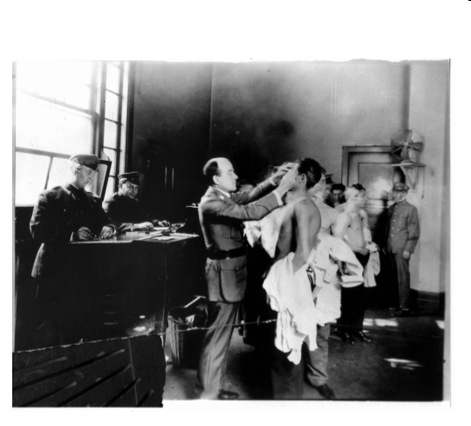
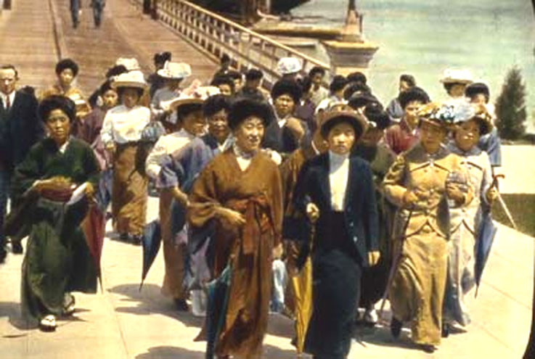
How…Asian immigration was limited
Chinese Exclusion Act (1882):
  stop Chinese labor immigration
Gentlemen’s Agreement (1907)
  Japan agreed- no passports for Japanese laborers to USA
  San Francisco agreed to end segregation of Asian students in public schools

Slide 11
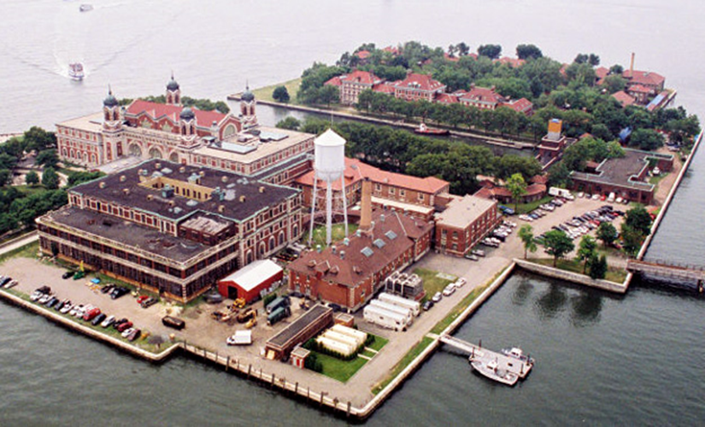

Slide 12
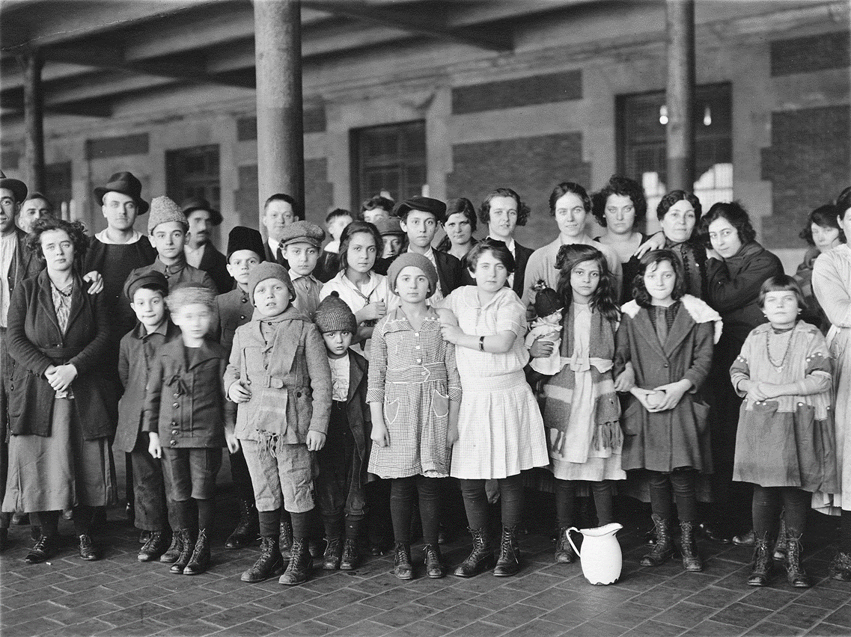

Slide 13
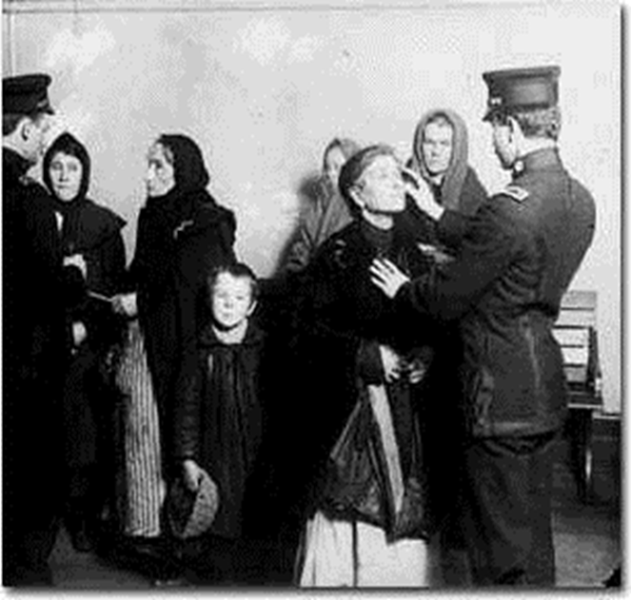

Slide 14
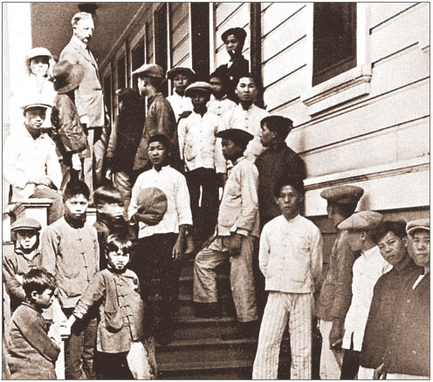
Some Chinese immigrants were detained at Angel Island for weeks or months in poor conditions.
They waited to see if they would be allowed to stay in the U.S.

Slide 16
Once in America, immigrants had to find a home and work. They also had to learn English and new customs.
Many stayed in cities and took jobs in factories. They lived in ethnic neighborhoods called ghettoes.
Large cities such as New York and Chicago had huge immigrant populations by 1890.
Notes:
16

Slide 17
Immigrants had some help coping with their new surroundings.
Settlement houses ran Americanization programs to help recent immigrants learn English and adopt American dress and diet.
Immigrants formed fraternal associations – based on ethnic or religious identity – which provided social services and financial assistance.
Notes:
17

Slide 18
Many believed that American society was a “melting pot” where white people of different nationalities blended to create a single culture.
This model excluded Asian immigrants, who became targets of social and legal discrimination.
Notes:
18

Slide 19
Despite the hopes of settlement workers, immigrants often held on to their traditions.
They established their own fraternal lodges, schools, and religious institutions such as churches.
Immigrants’ children, however, became more Americanized.
Notes:
19

Slide 20
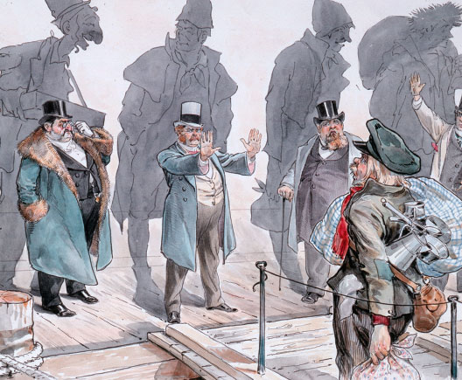
Immigrants often dealt with nativism and hostility from native-born white Americans.
Religious differences and competition for jobs and housing led to divisions and prejudices.

Slide 21
In 1882, Congress started to restrict immigration to the United States.
The Chinese Exclusion Act prohibited immigration by Chinese laborers, limited the rights of Chinese immigrants in the U.S., and forbade the naturalization of Chinese residents. Congress passed another law that prohibited the immigration of anyone who was a criminal, immoral, a pauper, or likely to need public assistance.
Notes:
21

Slide 22
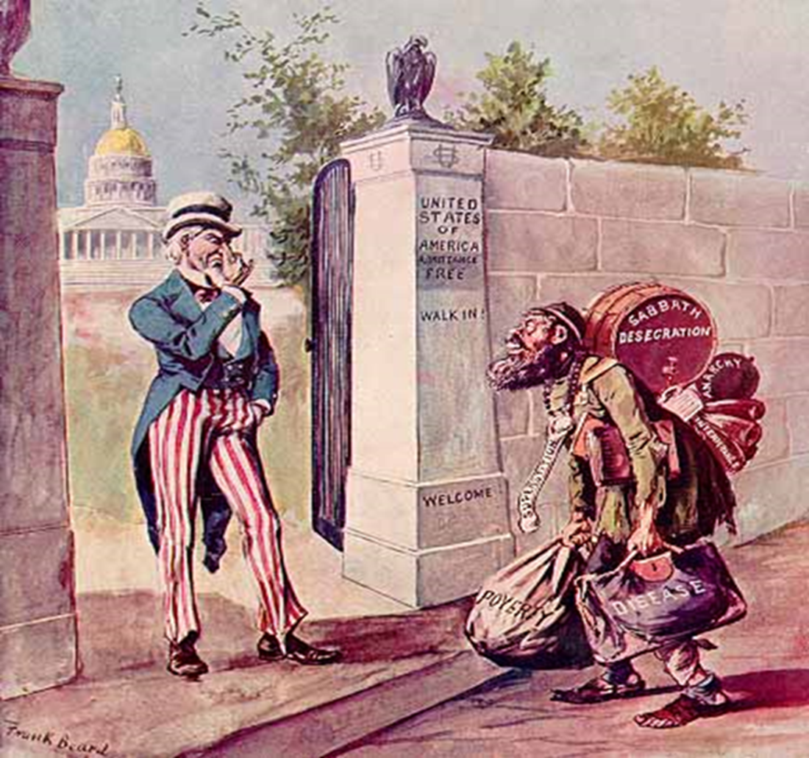

Slide 23
Immigrants transformed American society.
They fueled industrial growth.
They helped build the railroads and worked in factories, mills, and mines.
Their traditions became part of American culture.
Increasingly, they became active in labor unions and politics, and they demanded reforms.
Notes:
23

Slide 24

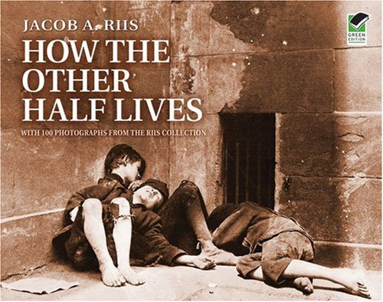
The Reform movement

Slide 25
Key terms and people
Progressivism – movement that believed honest and efficient government could bring about social justice
muckrakers – socially conscious journalists and writers who dramatized the need for reform
Lincoln Steffens – muckraking author of Shame of the Cities, exposed corruption in urban government
Jacob Riis – muckraking photographer and author of How The Other Half Lives, exposed the condition of the urban poor

Slide 26
Key terms and people
Social Gospel – belief that following Christian principles could bring about social justice
settlement house – community center that provided services for the urban poor
Jane Addams – leader in the settlement house movement
direct primary – allowed voters to select candidates rather than having them selected by party leaders

Slide 27
What areas did Progressives think were in need of the greatest reform?
Progressivism was a movement that believed the social challenges caused by industrialization, urbanization, and immigration in the 1890s and 1900s could be addressed.
Progressives believed that honest and efficient government could bring about social justice.

Slide 28
believed industrialization and urbanization had created social and political problems.
were mainly from the emerging middle class.
wanted to reform by using logic and reason.
Progressives were reformers who:

Slide 29
Progressives believed honest and efficient government could bring about social justice.
They wanted to end corruption.
They tried to make government more responsive to people’s needs.
They believed that educated leaders should use modern ideas and scientific techniques to improve society.

Slide 30
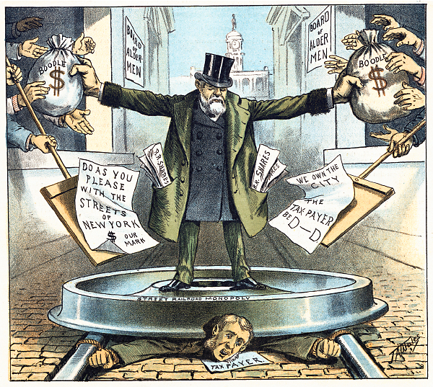
Progressives targeted a variety
of issues and problems.
corrupt political
machines
trusts and
monopolies
inequities
safety
city services
women’s suffrage

Slide 31

Lincoln Steffens
The Shame of the Cities
John Spargo
The Bitter Cry of the Children
Ida Tarbell
The History of Standard Oil
Muckrakers used investigative reporting to uncover and dramatize societal ills.

Slide 32
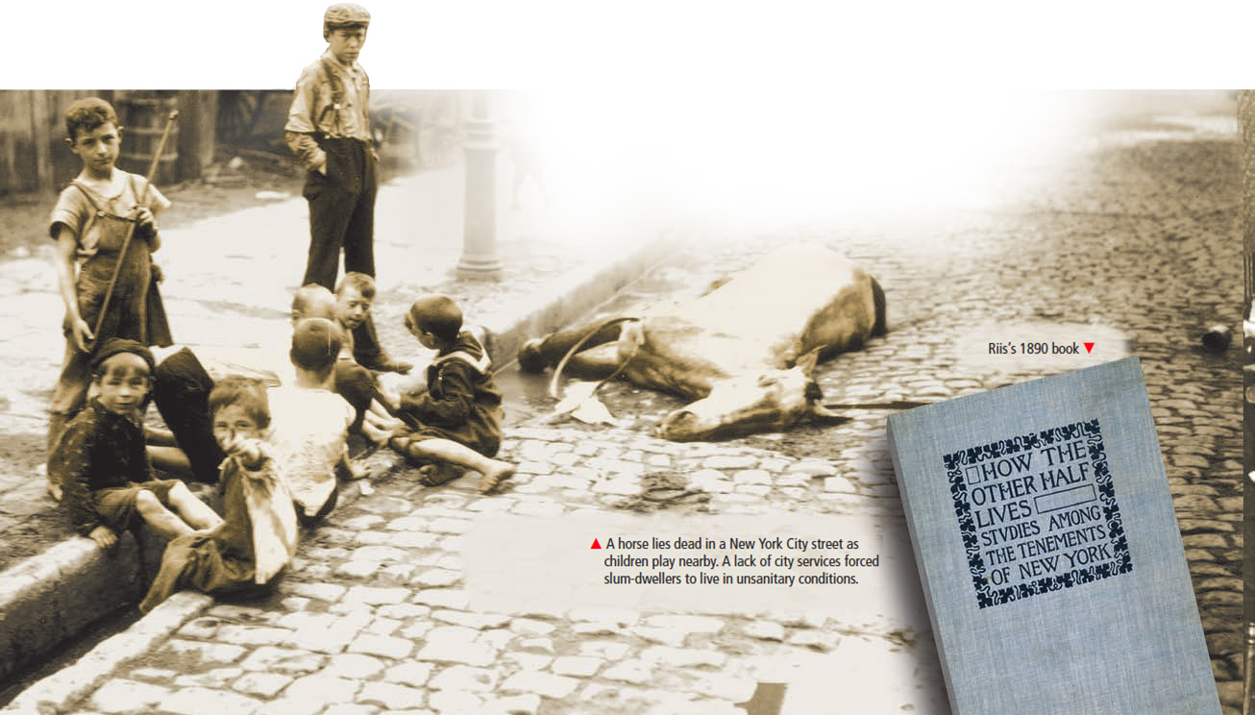
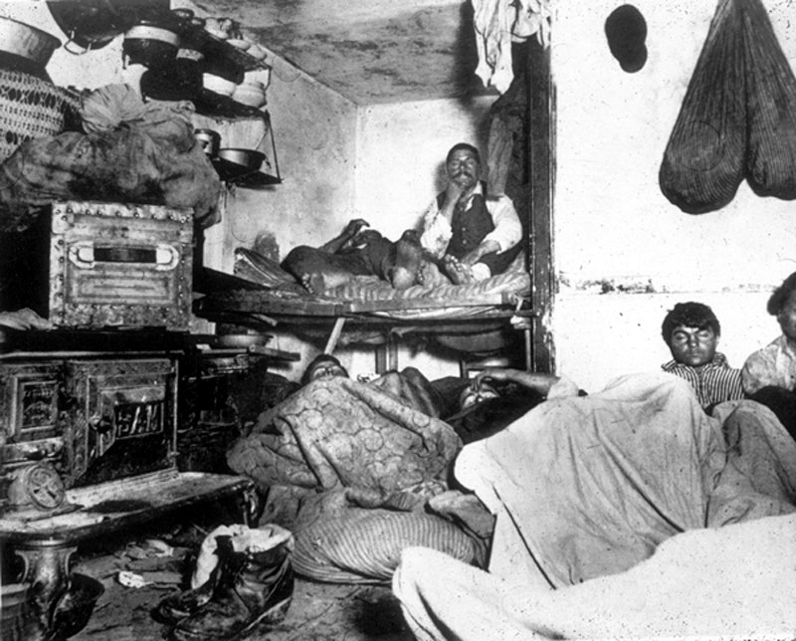
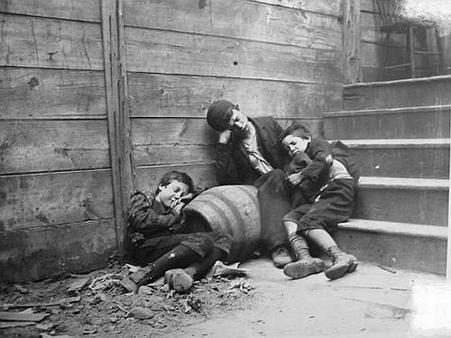
Jacob Riis exposed the deplorable conditions poor people were forced to live under in How the Other Half Lives.

Slide 33

The naturalist novel portrayed the struggle of common people.
Upton Sinclair’s novel, The Jungle, provided a shocking look at meatpacking in Chicago’s stockyards.

Slide 34
Theodore Dreiser’s, Sister Carrie, discussed factory conditions for working women.
Francis Ellen Watkins’s, Iola Leroy, focused on racial issues.
Frank Norris’s, The Octopus, centered on the tensions between farmers and the railroads.
Progressive novelists covered a wide range of topics.

Slide 35
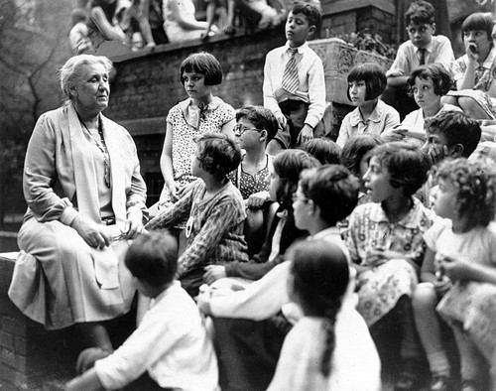
Jane Addams led the settlement house movement.
Her urban community centers provided social services for immigrants and the poor.
Christian reformers’ Social Gospel demanded a shorter work day and the end of child labor.

Slide 36
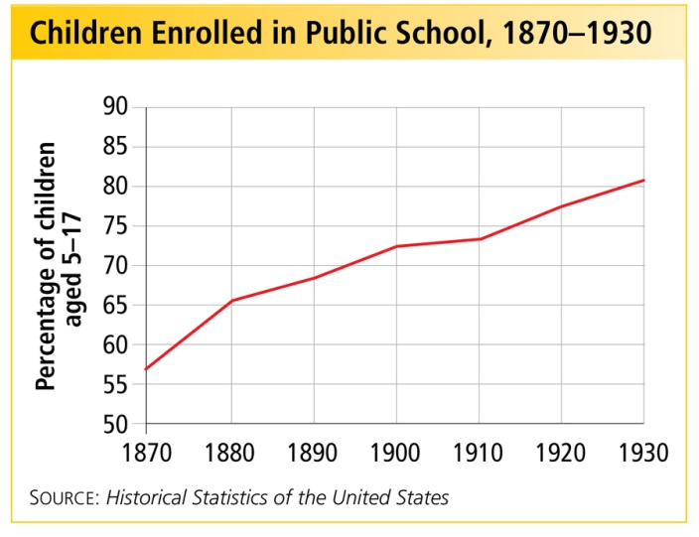
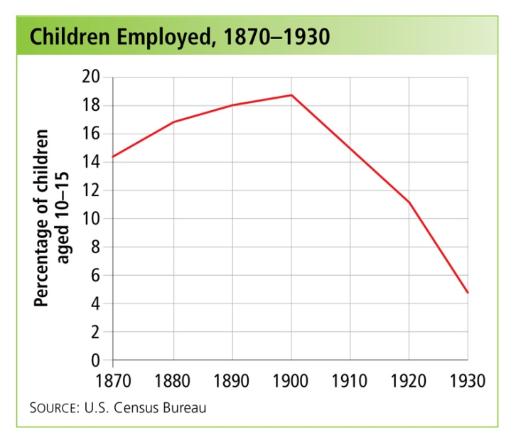
Progressives succeeded in reducing child labor and improving school enrollment.
The United States Children’s Bureau was created in 1912

Slide 37
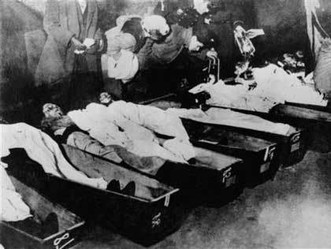
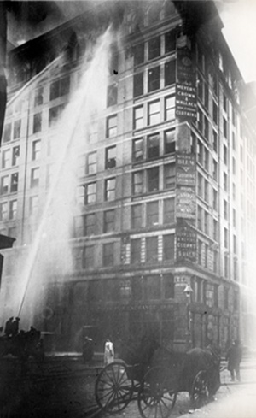
In the 1900s, the U.S. had the world’s worst rate of industrial accidents.
In 1911, 156 workers died in the Triangle Shirtwaist Fire. Many young women jumped to their deaths or burned.
Worker safety was an important issue for Progressives.

Slide 38
Government could
not be controlled by political bosses and business interests.
Government needed to be more efficient and more accountable to the people.
To reform society, Progressives realized they must also reform government.

Slide 39
Cities and states experimented with new methods of governing.
In Wisconsin, Governor Robert M. La Follette and other Progressives reformed state government to restore political control to the people.
direct primaries initiatives referendums recalls

Slide 40
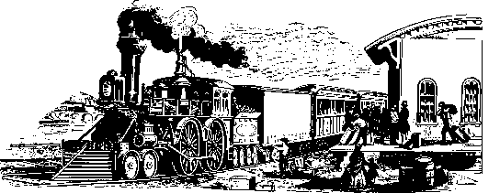
Progressive governors achieved state-level reforms of the railroads and taxes.
Two Progressive Governors, Theodore Roosevelt of New York and Woodrow Wilson of New Jersey, would become Progressive Presidents.
On the national level, in 1913, Progressives helped pass the 17th Amendment, providing for the direct election of United States Senators.

