Slide 1

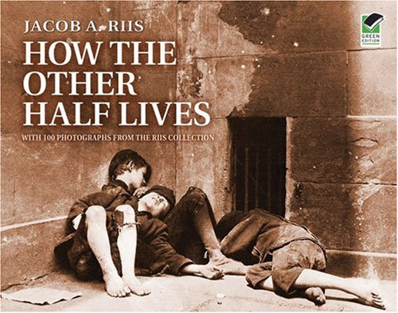
The Progressive era

Slide 2
Key terms and people
Progressivism – movement that believed honest and efficient government could bring about social justice
muckrakers – socially conscious journalists and writers who dramatized the need for reform
Lincoln Steffens – muckraking author of Shame of the Cities, exposed corruption in urban government
Jacob Riis – muckraking photographer and author of How The Other Half Lives, exposed the condition of the urban poor

Slide 3
Key terms and people
Social Gospel – belief that following Christian principles could bring about social justice
settlement house – community center that provided services for the urban poor
Jane Addams – leader in the settlement house movement
direct primary – allowed voters to select candidates rather than having them selected by party leaders

Slide 4
What areas did Progressives think were in need of the greatest reform?
Progressivism was a movement that believed the social challenges caused by industrialization, urbanization, and immigration in the 1890s and 1900s could be addressed.
Progressives believed that honest and efficient government could bring about social justice.

Slide 5
believed industrialization and urbanization had created social and political problems.
were mainly from the emerging middle class.
wanted to reform by using logic and reason.
Progressives were reformers who:

Slide 6
Progressives believed honest and efficient government could bring about social justice.
They wanted to end corruption.
They tried to make government more responsive to people’s needs.
They believed that educated leaders should use modern ideas and scientific techniques to improve society.

Slide 7
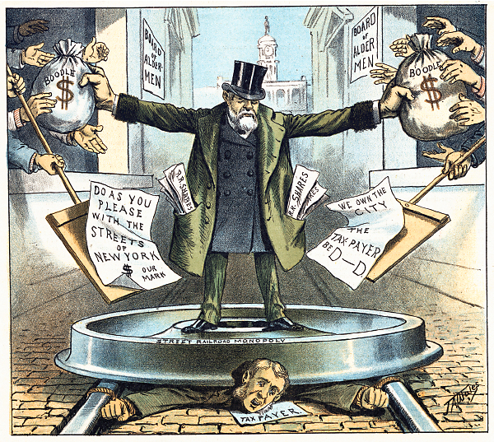
Progressives targeted a variety
of issues and problems.
corrupt political
machines
trusts and
monopolies
inequities
safety
city services
women’s suffrage

Slide 8

Lincoln Steffens
The Shame of the Cities
John Spargo
The Bitter Cry of the Children
Ida Tarbell
The History of Standard Oil
Muckrakers used investigative reporting to uncover and dramatize societal ills.

Slide 9
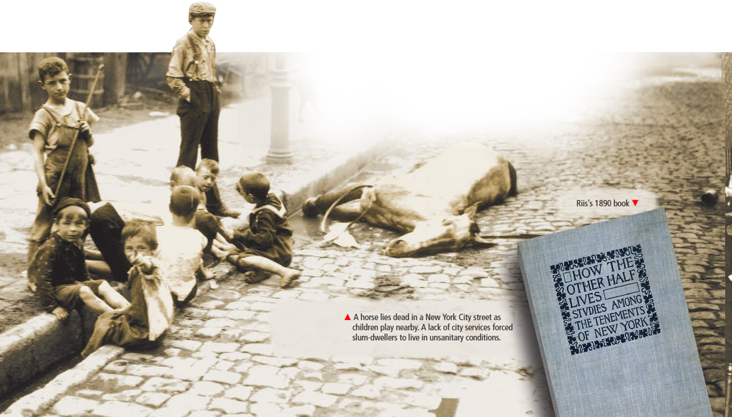
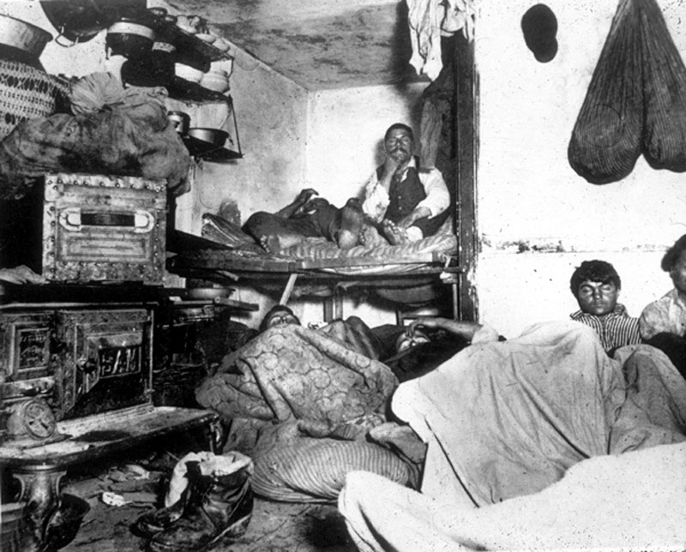
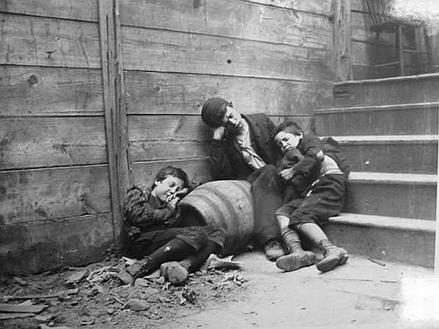
Jacob Riis exposed the deplorable conditions poor people were forced to live under in How the Other Half Lives.

Slide 10

The naturalist novel portrayed the struggle of common people.
Upton Sinclair’s novel, The Jungle, provided a shocking look at meatpacking in Chicago’s stockyards.

Slide 11
Theodore Dreiser’s, Sister Carrie, discussed factory conditions for working women.
Francis Ellen Watkins’s, Iola Leroy, focused on racial issues.
Frank Norris’s, The Octopus, centered on the tensions between farmers and the railroads.
Progressive novelists covered a wide range of topics.

Slide 12
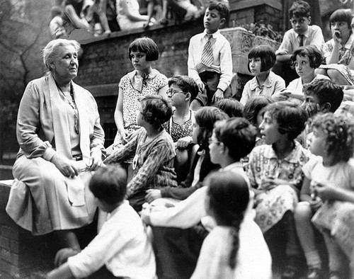
Jane Addams led the settlement house movement.
Her urban community centers provided social services for immigrants and the poor.
Christian reformers’ Social Gospel demanded a shorter work day and the end of child labor.

Slide 13
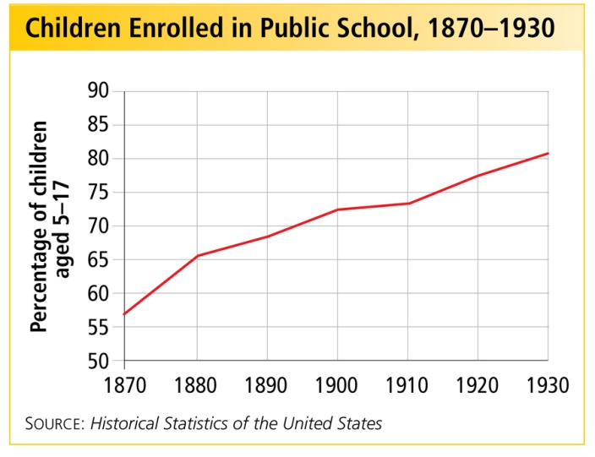
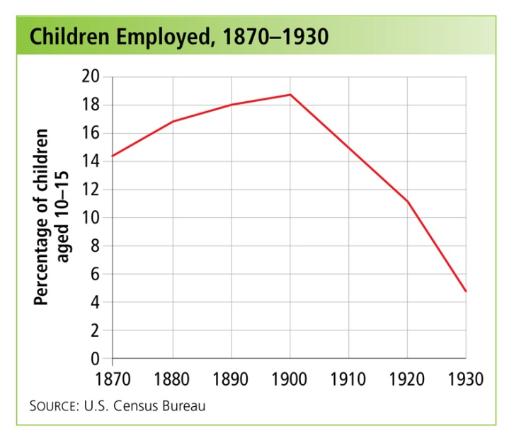
Progressives succeeded in reducing child labor and improving school enrollment.
The United States Children’s Bureau was created in 1912

Slide 14
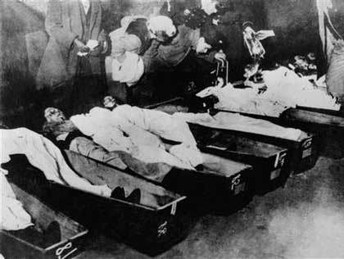
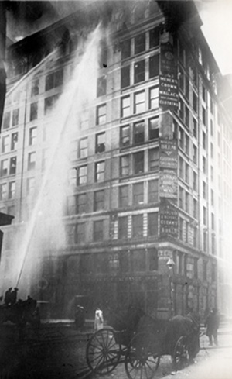
In the 1900s, the U.S. had the world’s worst rate of industrial accidents.
In 1911, 156 workers died in the Triangle Shirtwaist Fire. Many young women jumped to their deaths or burned.
Worker safety was an important issue for Progressives.

Slide 15
Government could
not be controlled by political bosses and business interests.
Government needed to be more efficient and more accountable to the people.
To reform society, Progressives realized they must also reform government.

Slide 16
Cities and states experimented with new methods of governing.
In Wisconsin, Governor Robert M. La Follette and other Progressives reformed state government to restore political control to the people.
direct primaries initiatives referendums recalls

Slide 17
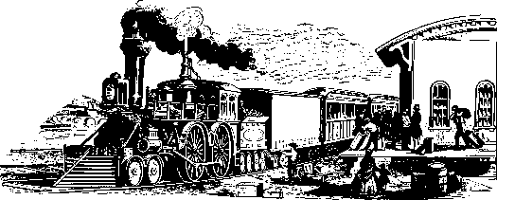
Progressive governors achieved state-level reforms of the railroads and taxes.
Two Progressive Governors, Theodore Roosevelt of New York and Woodrow Wilson of New Jersey, would become Progressive Presidents.
On the national level, in 1913, Progressives helped pass the 17th Amendment, providing for the direct election of United States Senators.

Slide 18
Terms and People
Florence Kelley – founded the National Consumer’s League known as the NCL
National Consumer’s League (NCL) – labeled and publicized “goods produced under fair, safe, and healthy working conditions”
temperance movement – campaign to end the production, sale, and use of alcohol
Margaret Sanger – opened the first birth control clinic
Ida B. Wells – helped to found the National Association of Colored Women

Slide 19
Terms and People (continued)
suffrage – the right to vote
Carrie Chapman Catt – president of the NAWSA, campaigned to pass women’s suffrage at both the state and national levels
NAWSA – National American Woman Suffrage Association
Alice Paul – social activist, led women to picket at the White House
Nineteenth Amendment – 1919, granted women the right to vote
Notes:
19

Slide 20

How did women of the Progressive Era make progress and win the right to vote?
In the early 1900s, many women were no longer content playing a limited role in society. Activists helped bring about Progressive reforms including women’s suffrage.
Women would continue the struggle to expand their roles and rights in the future.

Slide 21

By the early 1900s, a growing number of middle-class women wanted to do more than stay at home as wives and mothers.
Colleges like Pennsylvania’s Bryn Mawr and New York’s School of Social Work armed middle-class women with education and modern ideas.
However, most poor women continued to labor long hours, often under dangerous or dirty conditions.

Slide 22
  They worked long hours in factories and sweatshops, or as maids, laundresses or servants.
  They were paid less and often didn’t get to keep their wages.
  They were intimidated and bullied by employers.
Progressive reforms addressed working women’s conditions:
Notes:
22

Slide 23
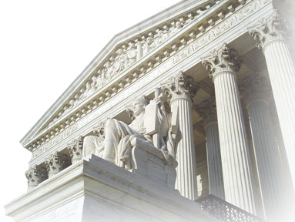
Reformers saw limiting the length of a woman’s work day as an important goal and succeeded in several states.
In Muller v. Oregon, the
Supreme Court ruled that states could legally limit a women’s
work day.
This ruling recognized the
unique role of women as
mothers.

Slide 24
In 1899, Florence Kelley founded the Women’s Trade Union League which worked for a federal minimum wage and a national eight-hour workday.
The WTUL also created the first workers’ strike fund, which helped support families who refused to work in unsafe or unfair conditions.

Slide 25

Progressives supported the temperance movement.
They felt that alcohol often led men to spend their earnings on liquor, neglect their families, and abuse their wives.
The Woman’s Christian Temperance Union grew steadily until the passage of the 18th Amendment which banned the sale and production of alcohol in 1919.

Slide 26
In 1916, Margaret Sanger opened the first birth control clinic. She believed that having fewer children would lead to healthier women.
In 1921, Sanger founded the American Birth Control League to make information available to women.
She was jailed. The courts eventually ruled that doctors could give out family planning information.
Notes:
26

Slide 27
African Americans also worked for women’s rights.
Ida B. Wells founded the National Association of Colored Women or NACW in 1896.
The NACW supported day care centers for the children of working parents.
Wells also worked for suffrage, to end lynchings, and to stop segregation in the Chicago schools.
Notes:
27

Slide 28
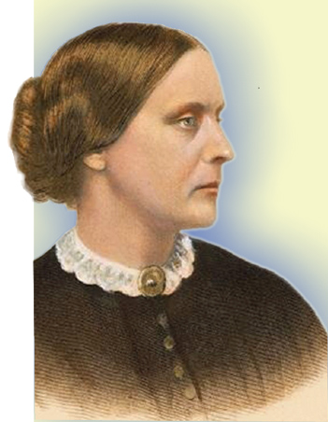
Ultimately suffrage was seen as the only way to ensure that government protected children, fostered education, and supported family life.
Since the 1860s, Susan B. Anthony
and Elizabeth Cady Stanton
worked relentlessly for
women’s suffrage.
Still, by the 1890s, only Wyoming
and Colorado allowed women to vote.
Susan B. Anthony

Slide 29
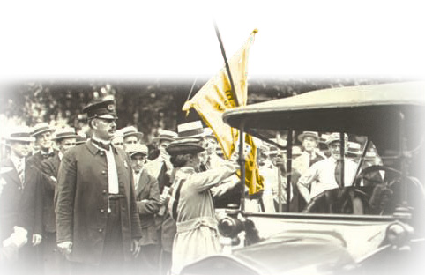
In 1917, social activists led by Alice Paul formed the National Woman’s Party. Their radical actions made the suffrage movement’s goals seem less
dramatic by comparison.
The NWP picketed the White House.
Hundreds of suffragettes were arrested and jailed.
Notes:
29

Slide 30
President of the National American Suffrage Association, Carrie Chapman Catt, promoted a two-part strategy to gain the vote for women.
  1
  NAWSA lobbied Congress for a constitutional amendment.
  Supporters, called suffragettes, used the referendum process to pass state laws.
  2
Notes:
30

Slide 31
The National Association Opposed to Woman’s Suffrage feared voting would distract women from their family roles.
Many men and women were offended by Paul’s protests in front of the White House. A mob shredded her signs and pickets.
Not all women supported suffrage.

Slide 32
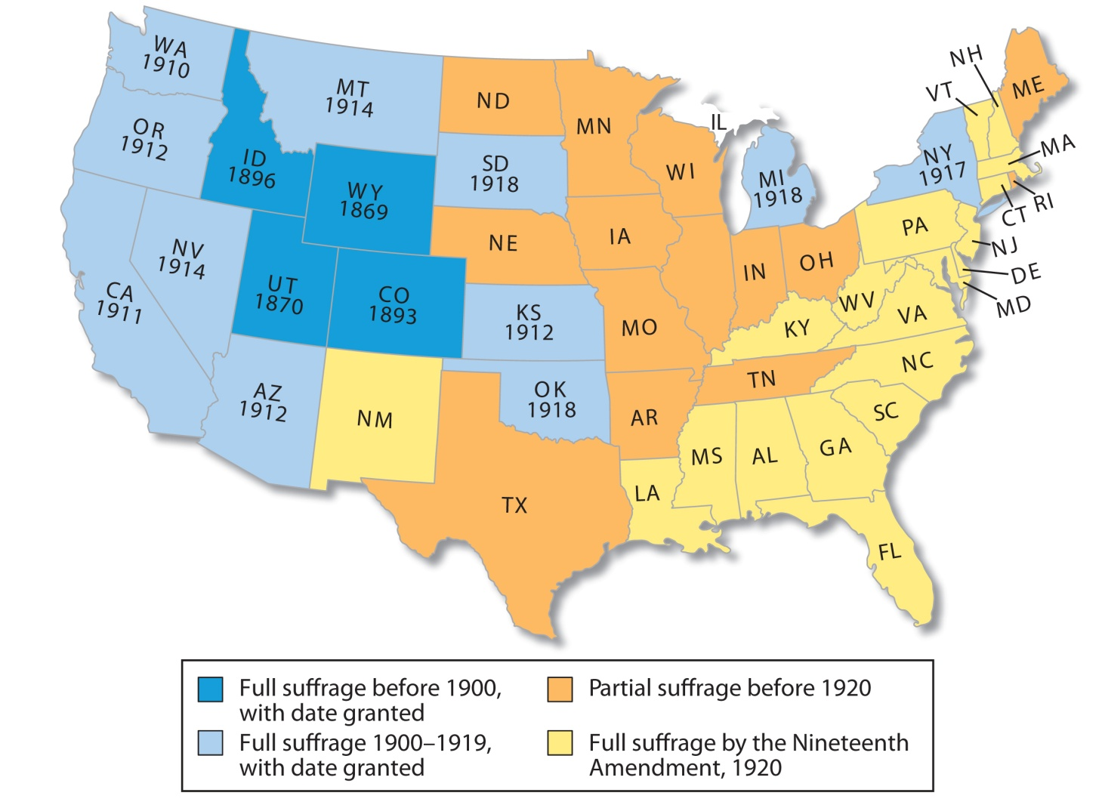
States gradually granted suffrage to women, starting in the western states.

Slide 33
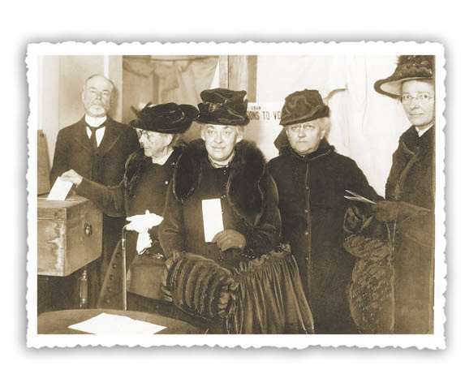
In June 1919, the Nineteenth Amendment was passed by Congress. The amendment stated that the vote “shall not be denied or abridged on account of sex.”
In November 1920, women nationwide voted in a presidential election for the first time.
Notes:
33

Slide 34
Terms and People
Theodore Roosevelt – energetic Progressive who became the youngest president in 1901
Square Deal – Roosevelt’s program to keep the wealthy and powerful from taking advantage of small business owners and the poor
Hepburn Act – gave the Interstate Commerce Committee power to limit railroad company prices
Meat Inspection Act – gave federal agents power to inspect and monitor the meatpacking industry

Slide 35
Terms and People (continued)
Pure Food and Drug Act – gave the federal government responsibility for insuring food and medicine are safe
John Muir – California naturalist who advocated for the creation of Yosemite National Park
Gifford Pinchot – forestry official who proposed managing the forests for later public use
Notes:
35

Slide 36
Terms and People (continued)
National Reclamation Act – gave the federal government power to decide where and how water would be distributed in arid western states
New Nationalism – Roosevelt’s 1912 plan to restore the government’s trustbusting power
Progressive Party – Roosevelt’s party in the 1912 election
Notes:
36

Slide 37

What did Roosevelt think government should do for citizens?
After a number of weak and ineffective Presidents, Theodore Roosevelt was a charismatic figure who ushered in a new era.
Roosevelt passed Progressive reforms, expanded the powers of the presidency, and changed how Americans viewed the roles of the President and the government.

Slide 38
In 1901, 43-year-old Theodore Roosevelt became the United States’ youngest president, rising quickly as a Progressive idealist.
Shortly after graduation from Harvard in 1880, he was elected to the New York State Assembly.
Following the death of his wife three years later, he headed west to become a rancher.
He had a reputation for being smart, opinionated, and extremely energetic.

Slide 39
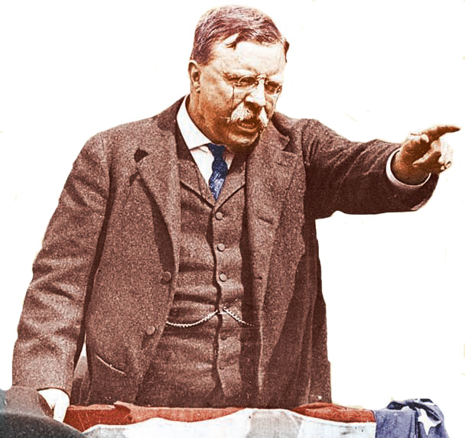
  In 1889 he returned, earning a reputation for fighting corruption on New York City’s Board of Police Commissioners.
  Chosen by President McKinley to be Assistant Secretary of the Navy, he resigned to organize the Rough Riders at the start of the Spanish American War.
  He returned a war hero and was elected Governor of New York in 1898.

Slide 40
But, in 1901, William McKinley was assassinated.
As Governor, his Progressive reforms upset Republican leaders. To get him out of New York, President McKinley agreed to make Roosevelt his running mate in 1900. They won easily.
As President, Roosevelt dominated Washington. He was so popular that even a toy, the
teddy bear,
was named
for him.

Slide 41
Roosevelt greatly expanded the power of the presidency and the role of government beyond that of helping big business.
His Square Deal program promised fairness and honesty from government.
He used the power of the federal government on behalf of workers and the people.

Slide 42
In 1902, Roosevelt threatened a federal
take-over of coal mines when owners
refused to compromise on hours.
This was the first time the federal government had stepped into a labor dispute on the side of workers.
The Department of Commerce and Labor was established to prevent capitalists from abusing their power.

Slide 43
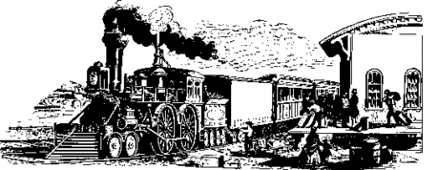
Roosevelt also took on the railroads after the courts stripped the Interstate Commerce Commission’s authority to oversee rail rates.
Elkins Act (1903)
Allowed the government to fine railroads that gave special rates to favored shippers, a practice that hurt farmers
Hepburn Act (1906)
Empowered the ICC to enforce limits on the prices charged by railroad companies for shipping, tolls, ferries, and pipelines

Slide 44
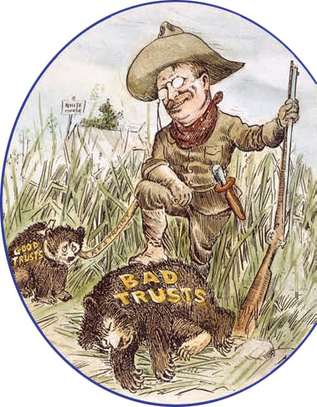
Roosevelt was known as a trustbuster.
He used the Sherman Antitrust Act to
file suits against
what he saw as
“bad” trusts, those that bullied small businesses or
cheated consumers.
Notes:
44

Slide 45
The Meat Inspection Act provided for federal inspections and monitoring of meat plants.
The Pure Food and Drug Act banned the interstate shipments of impure or mislabeled food or medicine.
Roosevelt backed Progressive goals to protect consumers by making the federal government responsible for food safety.
Today, the Food and Drug Administration (FDA) tests and monitors the safety of food and medicine.
Notes:
45

Slide 46
Roosevelt had a deep reverence for nature, which shaped his policies.
Pinchot felt that resources should be managed and preserved for public use.
Roosevelt also admired John Muir, who helped establish Yosemite National Park, and who advised him to set aside millions of acres of forestland.
As a Progressive, Roosevelt supported Gifford Pinchot’s philosophy on the preservation of resources.
Notes:
46

Slide 47
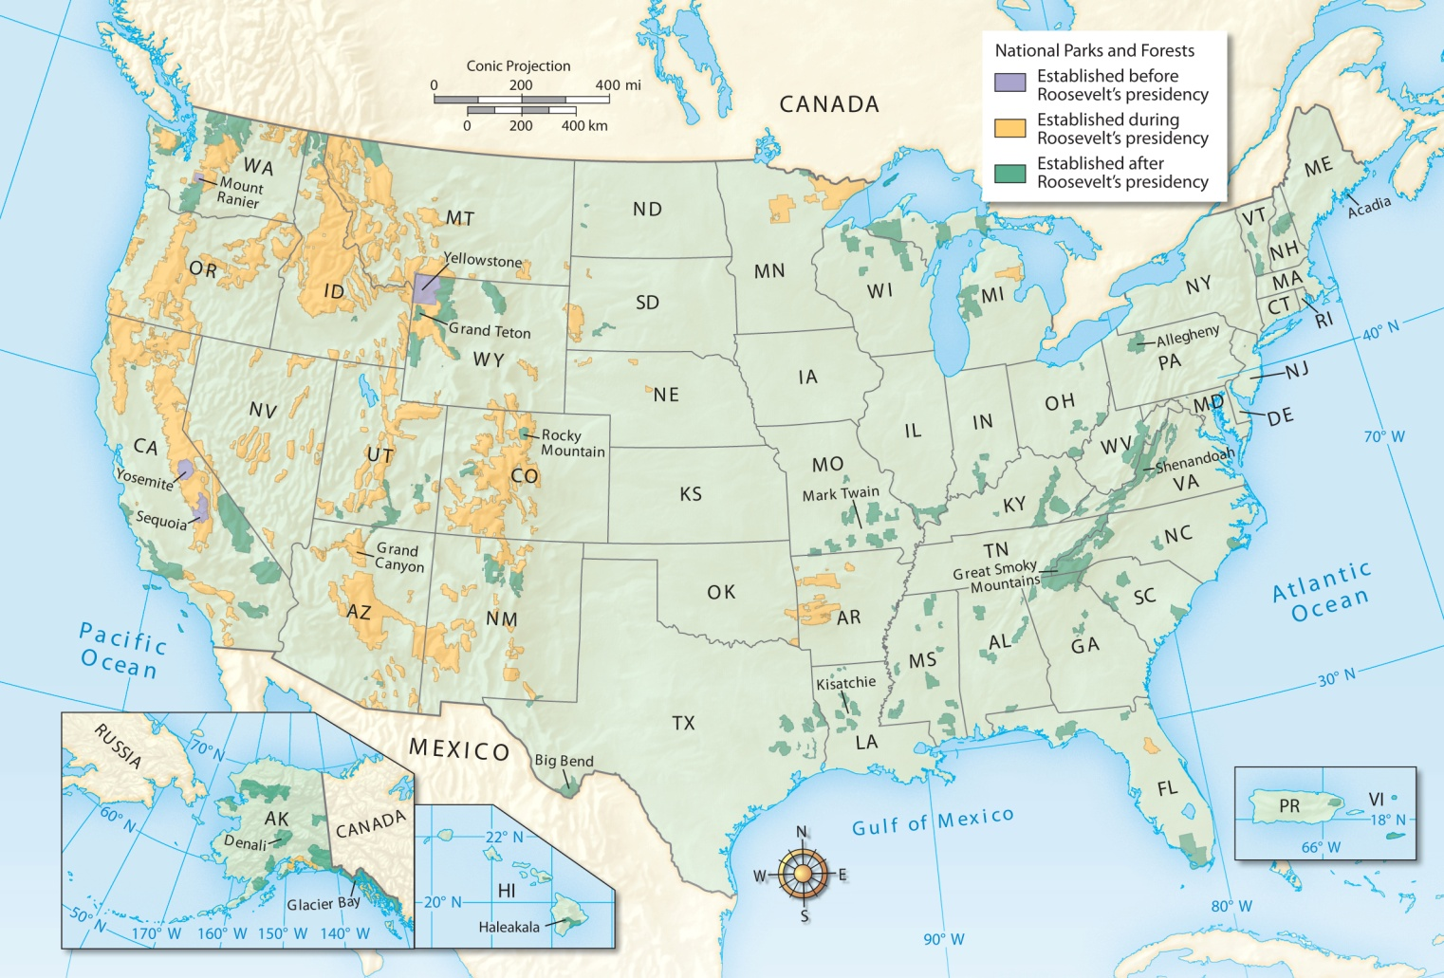
Roosevelt added 100 million acres to the National Park and Forest System.

Slide 48


This Act gave the federal government power to distribute water in the arid west, effectively giving government the power to decide where and how water would be dispensed.
In another example of the government’s authority, Congress passed the National Reclamation
Act of 1902.

Slide 49
In 1908, Roosevelt retired. But he soon disagreed with his successor William Howard Taft on several issues.
1909 | Taft approved the Aldrich Act which didn’t lower tariffs as much as Roosevelt wanted.
1910 | Taft signed the Mann-Elkins Act providing for federal control over telephone and telegraph rates.
1911 | Taft relaxed the hard line set by the Sherman Antitrust Act.
Notes:
49

Slide 50
Taft did not share Roosevelt’s views on trusts but this was not the only area in which they disagreed.
Taft believed that a monopoly was acceptable as long as it didn’t unreasonably squeeze out smaller companies.
When Taft fired Gifford Pinchot and overturned an earlier antitrust decision, Roosevelt angrily decided to oppose Taft and ran for president again.
Notes:
50

Slide 51
Roosevelt promised to restore government trust-busting in a program he called New Nationalism.
Roosevelt’s candidacy split the Republican Party, which nominated Taft.
Roosevelt then accepted the nomination of the Progressive Party setting up a three-way race for the presidency in 1912.
Notes:
51

Slide 52
Terms and People
Woodrow Wilson – Progressive Democrat elected President in 1912
New Freedom – Wilson’s program to place strict government controls on corporations
Sixteenth Amendment – gave Congress the power to impose an income tax
Federal Reserve Act – placed the national banks under the control of a Federal Reserve Board

Slide 53
Terms and People (continued)
Federal Trade Commission – group appointed by the President to monitor business practices that might lead to a monopoly
Clayton Antitrust Act – strengthened anti-trust laws by spelling out specific practices in which businesses could not engage
Notes:
53

Slide 54
What steps did Wilson take to increase the government’s role in the economy?
Woodrow Wilson used the expanded power of the presidency to promote a far-reaching reform agenda.
Some of Wilson’s economic and antitrust measures are still important in American life today.

Slide 55
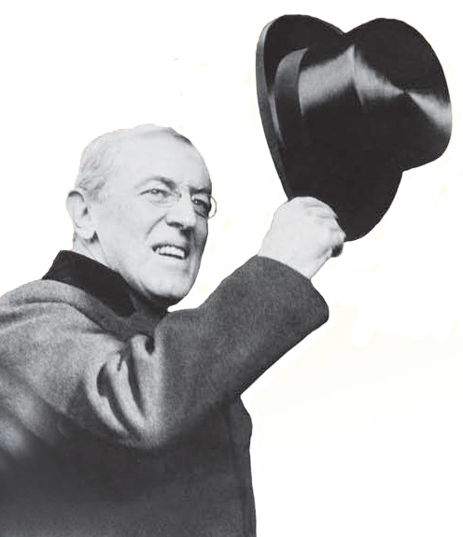
In 1912, the Republican Party was split between Progressives who backed Theodore Roosevelt and those loyal to incumbent William Howard Taft.
The split allowed Woodrow Wilson, the Democrat, to win easily in the Electoral College, though he did not receive a majority of the popular votes.

Slide 56
Woodrow Wilson
served as a college professor and President of Princeton University
served as Governor of New Jersey with a Progressive agenda
was the first southerner elected President in almost sixty years

Slide 57
Wilson felt that laws shouldn’t allow the strong to crush the weak. His New Freedom plan was similar to Roosevelt’s New Nationalism. It called for strict government controls over corporations.
Wilson promised to bring down the “triple wall of privilege,” tariffs, banks, and trusts.
In 1913, the Underwood Tariff Act cut tariffs leading to lower consumer prices.

Slide 58

The Underwood Act also provided for the creation of a graduated income tax, first permitted in 1913, under the newly ratified Sixteenth Amendment.
Progressives like Wilson felt it was only fair that the wealthy should pay a higher percentage of their income in taxes than the poor.
Revenue from the income tax more than offset the loss of funds from the lowered tariff.

Slide 59

Wilson passed the Federal Reserve Act of 1913. It established a system of regional banks to hold reserve funds for the nation’s commercial banks.
Still in place today, the Federal Reserve protects against any one person, bank, or region from controlling interest rates.
Previously, a few wealthy bankers could manipulate interest rates for their own profit.

Slide 60

Wilson strengthened antitrust laws. Like Roosevelt, he focused on trusts that used unfair practices.
The Federal Trade Commission was created in 1914 to monitor businesses to prevent monopolies, false advertising, and dishonest labeling.
Still in effect today, the FTC also prosecutes dishonest stock traders and regulates internet sales.

Slide 61
Like Roosevelt, Wilson only opposed trusts that engaged in unfair practices.
The Clayton Act also protected unions from being defined as trusts, allowing them more freedom to organize.
In 1914, the Clayton Antitrust Act defined specific activities in which businesses could not engage.
Notes:
61

Slide 62
In 1916, the Workingman’s Compensation Act provided wages for temporarily disabled civil service employees.
In 1916, the Adamson Act provided an eight-hour day for railway workers.
Wilson passed several Progressive laws that supported workers.
Federal laws today protect workers who are hurt on the job and limit hours in many industries.

Slide 63
Wilson did not always support workers, as shown in the Ludlow Massacre.
In 1913, coal miners went on strike in Ludlow, Colorado.
The company refused their demands and evicted workers from company housing.
Workers set up tents outside the company.
The Colorado National Guard was called. The Guardsmen fired on the tents and killed twenty-six people.
Wilson sent federal troops to restore order and break up the strike.
Notes:
63

Slide 64
The Progressive Era had a lasting effect on government, the economy, and society.
Political reforms included the:
initiative
referendum
recall
19th Amendment
Progressive reforms gave Americans more:
protection
control over private lives
control over businesses

Slide 65
Progressive Era Legislation and Amendments
Sherman Antitrust Act (1890) | Outlawed monopolies and practices that restrained trade
National Reclamation Act (1902) | Provided for federal irrigation projects in arid Western states
Elkins Act (1903) | Imposed fines on railroads that gave special rates to favored shippers
Hepburn Act (1906) | Allowed the government to regulate and sets maximum rates for railroads
Meat Inspection Act (1906) | Provided federal inspection of packing plants and meat sold across state lines
Pure Food and Drug Act (1906) | Provided federal inspection of foods, medicines for purity
Sixteenth Amendment (1913) | Gave Congress the power to collect an income tax

Slide 66
Progressive Era Legislation and Amendments (continued)
Seventeenth Amendment (1913) | Provided for the direct election of Senators by the voters of each state
Underwood Tariff Act (1913) | Lowered tariffs on imported goods, established a graduated income tax
Federal Reserve Act (1913) | Created the Federal Reserve Board to oversee banks and reserve funds
Federal Trade Commission Act (1914) | Established the Federal Trade Commission to monitor business
Clayton Antitrust Act (1914) | Spelled out specific activities that businesses can not engage in
Eighteenth Amendment (1919) | Banned the making, selling, or transporting of alcoholic beverages
Nineteenth Amendment (1920) | Gave women the right to vote in all elections

Slide 67
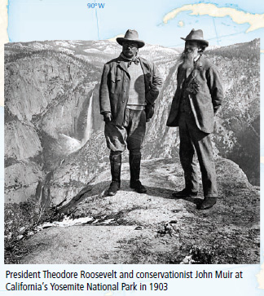
Progressive management of natural resources has impacted our environment including national parks, dams, and forests.
Progressive legislation has profoundly impacted our economy including antitrust laws, the Federal Reserve System, and consumer protection.
Water distribution remains a hotly debated issue.

Slide 68
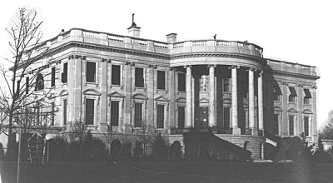
Many issues still remain involving dishonest sellers, unfair employment practices, and problems in schools, cities, the environment, and public health.
Progressives succeeded in establishing the idea that government can take action in these areas.
Notes:
68

